Slide 1


Software 2.0 Team Kickoff Deck
Presented by Vik Ramprakash

Slide 2
Meeting Overview
Purpose: Software and team alignment for Cell and Silver Guardian 2.0, Jetson integration
Attendees: Vik Ramprakash, Dave, Deva, Varun
Date: October 24, 2025

Slide 3
Hardware goals
Transitioning from CM4 to Jetson for AI-driven behavior and vital-sign monitoring.
Shrinking the carrier board for Silver Guardian 2.0.
Reviewed Cell, Silver, and Neo Guardians.
Ongoing R&E testing for product validation.
Dustin and Antonio joining on Nov 1

Slide 4
Carrier Board Design Team
Antonio: Original board designer; leading redesign.
Dustin: RF/systems engineer
Board Variants:
Cell Guardian – Production (PoE + CAT6)
Silver Guardian 1.0 – Retail model
Silver Guardian 2.0 – Jetson-based version
Neo Guardian – Future NICU design
Dental

Slide 5
Next Steps
Vik: Create product timeline deck
Neil: Review deck & share requirements.
Antonio: Visit SancSoft; mentor Dustin.
Dustin: Begin carrier board design.
Team: Evaluate existing board for Jetson mods

Slide 6
Hardware & Software Transition Plan
Move from Raspberry Pi CM4 → NVIDIA Jetson Nano/Orin.
Move from 5.8Ghz board to 24GHz Sensor board
Add edge AI behavioral analysis.
Integrate power & network architecture.

Slide 7
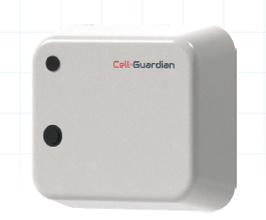
Cell-Guardian 2.0 Goals
Better Views
Jetson AI integration.
Enhanced cooling & waterproofing.
Continue Cell-Guardian 1.0 sales during R&D.

Slide 8
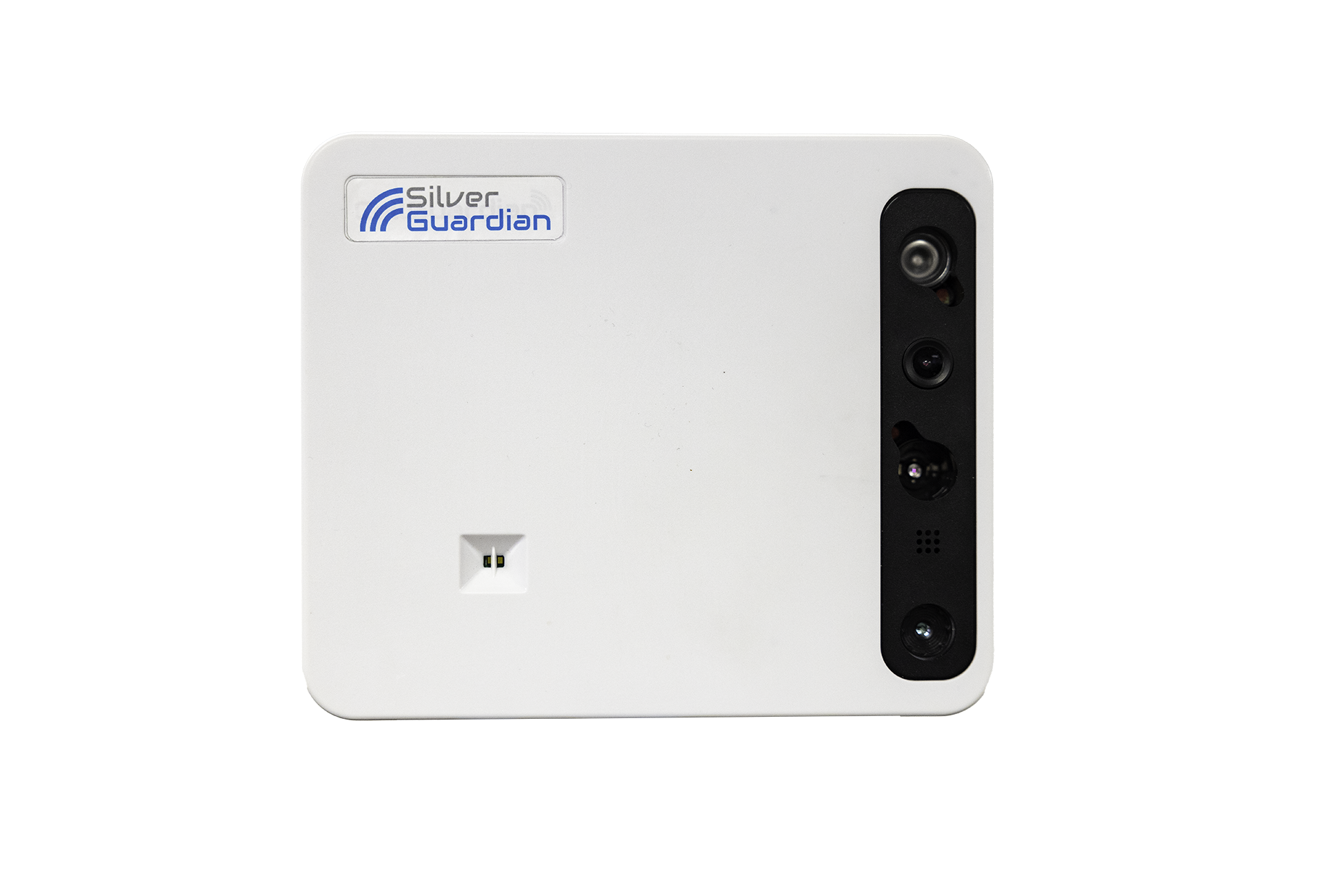
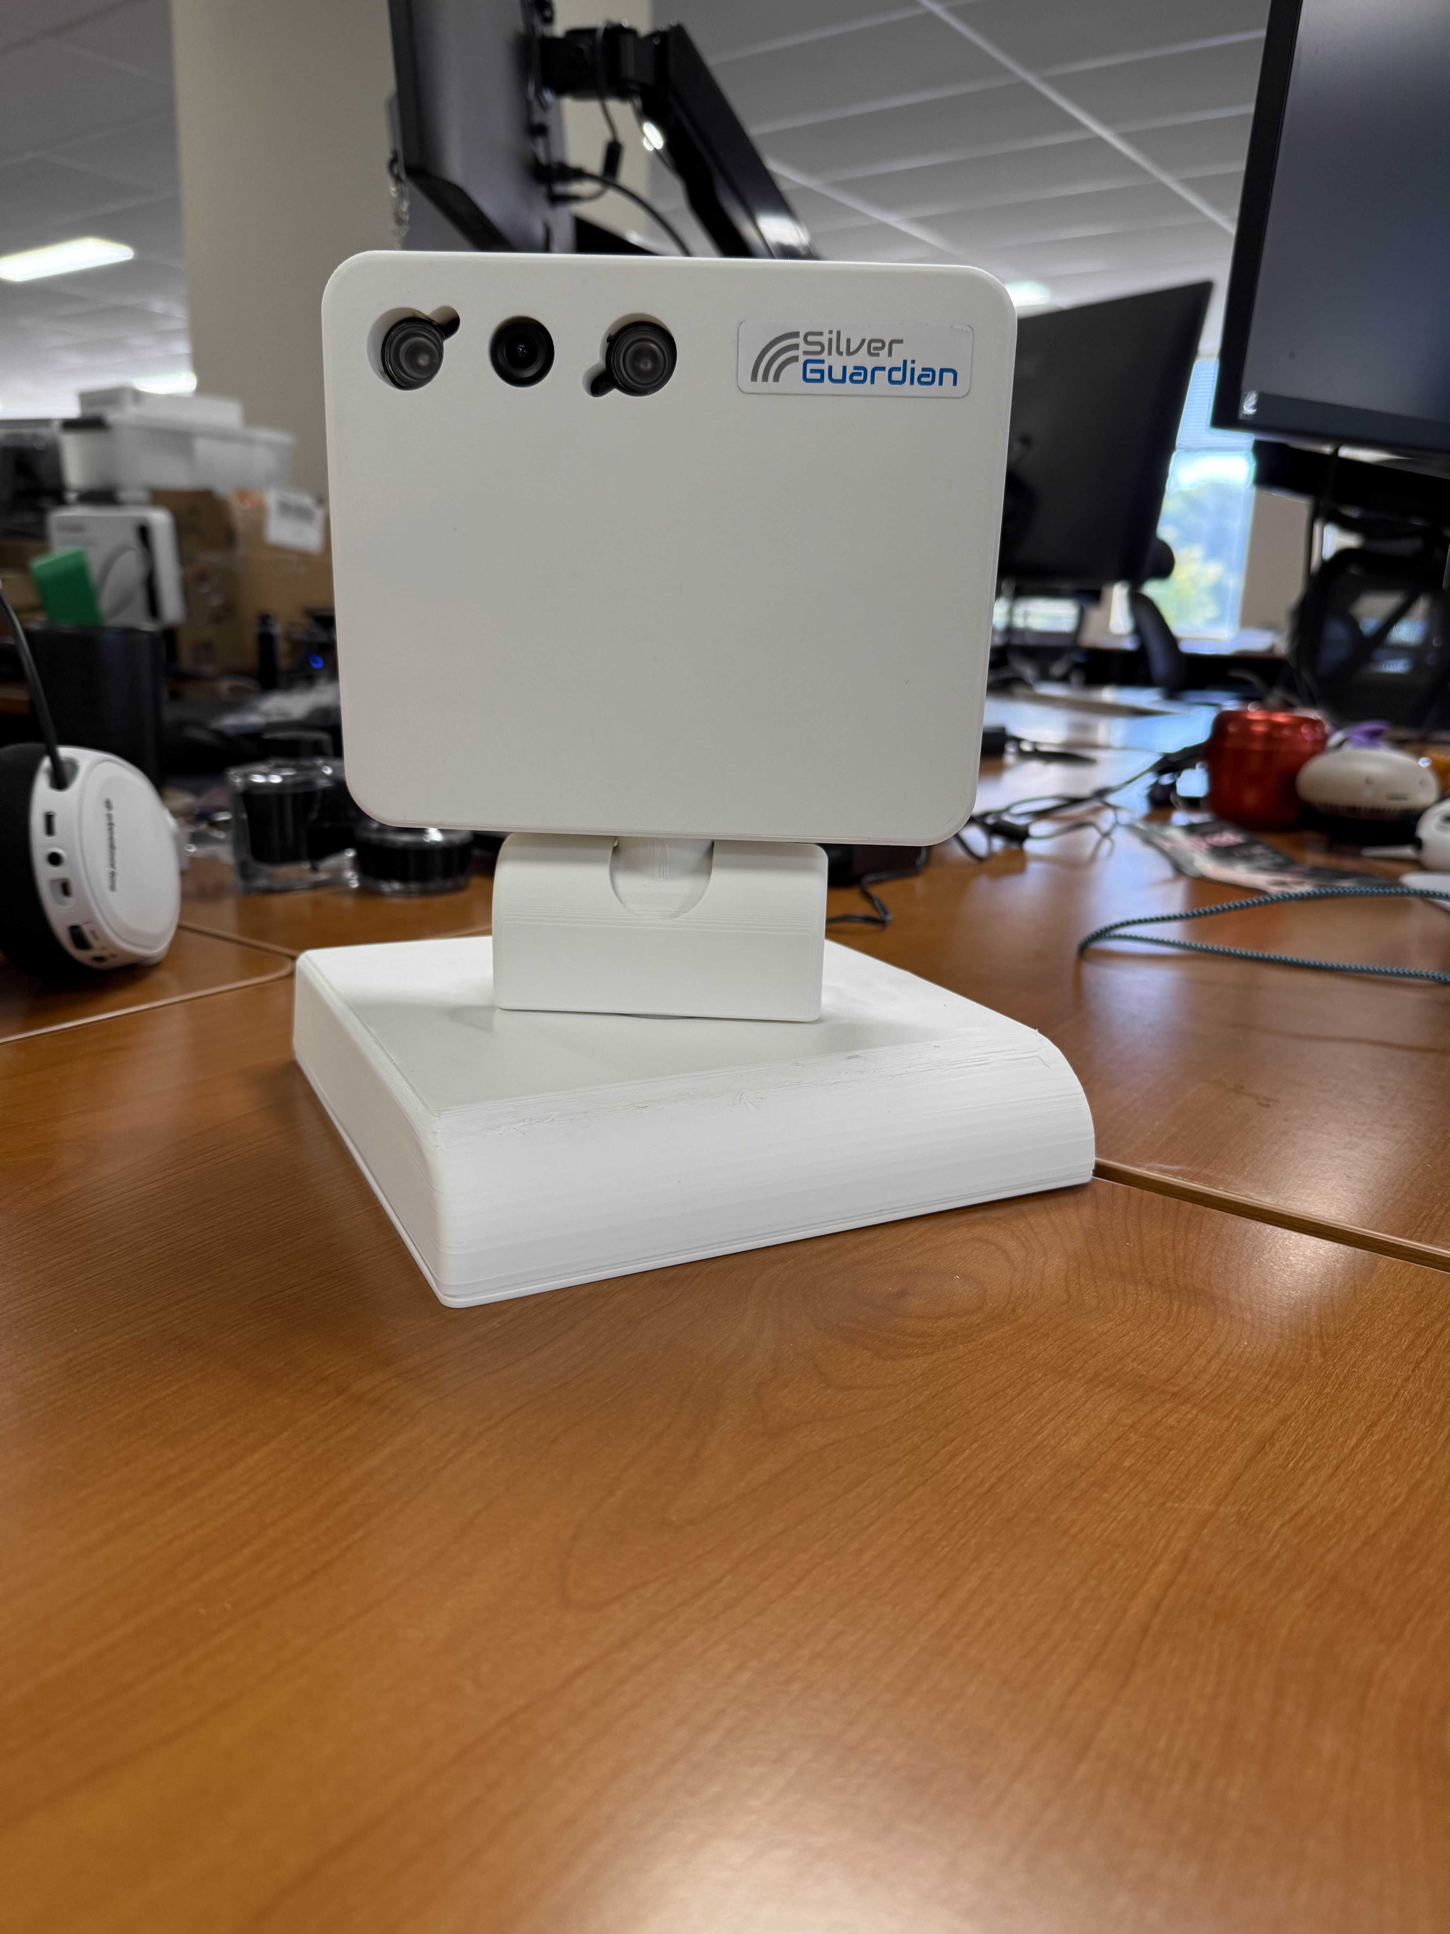

Silver Guardian 2.0 Goals
Compact form factor & better aesthetics.
Jetson AI integration.
Pan/Tilt motor for tracking
Better Silver-Guardian App development
Continue Silver 1.0 sales during R&D.

Slide 9
Immediate Deliverables
Vik: Timeline deck
Varun:
Review Q4 2025 release and Q1 2026
All PEN TESTING CODE to be secured from SancSoft – This was built for our team and will need to be run for Silver-Guardian 2.0
Dave:
Issues for Cell-Guardian & Silver-Guardian– Demo and Live views
Deva:
Fix issues identified by Dave
Limit use of SancSoft help unless neccessary
Secure Silver-Guardian App and transfer to Brahm India for Silver-Guardian 2.0 App upgrade

Slide 10
Summary & Alignment
Clear responsibilities, parallel progress.
Jetson aligns with Companion AI roadmap.
Dual focus: Revenue (Silver 1.0, Cell 1.0) + Innovation (Silver 2.0, Cell 2.0).
Neo-Guardian IRB
Dental sensor integration and vital-sign pilots.

Slide 11

Thank you.
CONTACT
Vik Ramprakash
CEO
E: Vik.Ramprakash@Rahmsd.com
www.rahmsd.com

